Slide 1

Ch17. Interacting with the file System
And the Server
Siva R Jasthi
ICS325 – Internet Application Development
Information and Computer Sciences
Metropolitan State University

Slide 2
Outline
Uploading files with PHP
Using directory functions
Interacting with files on the server
Executing programs on the server
Using server environment variables
https://www.php.net/manual/en/features.file-upload.php

Slide 3
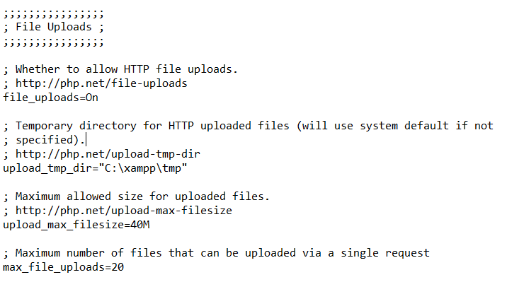
xampp/php/php.ini configuration

Slide 4
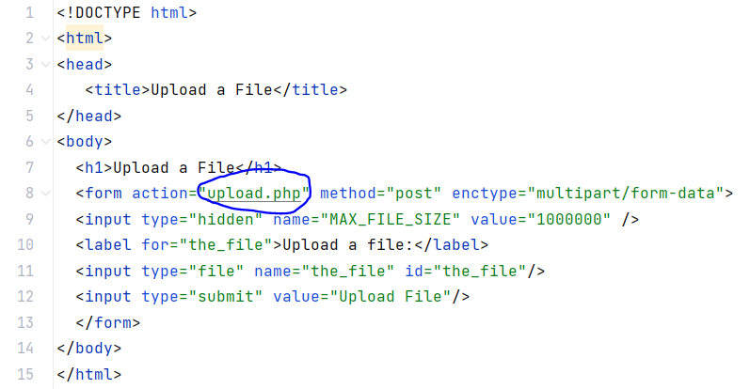
HTML for file upload

Slide 5
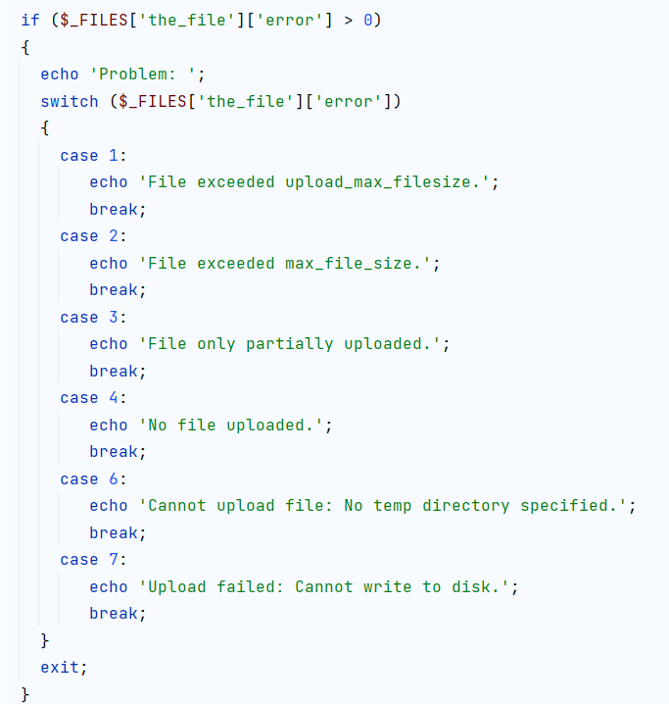
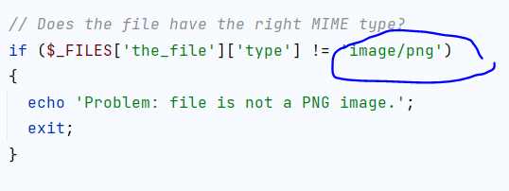
Upload processing on PHP side (error checking)
Primarily error checking.

Slide 6
Super global $_FILES[ ]
■ The value stored in $_FILES['the_file']['tmp_name'] is the temporary name and location where the file has been temporarily stored on the web server.
■ The value stored in $_FILES['the_file']['name'] is the original name of the uploaded file.
■ The value stored in $_FILES['the_file']['size'] is the size of the file in bytes.
■ The value stored in $_FILES['the_file']['type'] is the MIME type of the file—for example, text/plain or image/png.
■ The value stored in $_FILES['the_file']['error'] will give you any error codes associated with the file upload.

Slide 7
Upload Error Messages
UPLOAD_ERR_OK
Value: 0; There is no error, the file uploaded with success.
UPLOAD_ERR_INI_SIZE
Value: 1; The uploaded file exceeds the upload_max_filesize directive in php.ini.
UPLOAD_ERR_FORM_SIZE
Value: 2; The uploaded file exceeds the MAX_FILE_SIZE directive that was specified in the HTML form.
UPLOAD_ERR_PARTIAL
Value: 3; The uploaded file was only partially uploaded.
UPLOAD_ERR_NO_FILE
Value: 4; No file was uploaded.
UPLOAD_ERR_NO_TMP_DIR
Value: 6; Missing a temporary folder.
UPLOAD_ERR_CANT_WRITE
Value: 7; Failed to write file to disk.
UPLOAD_ERR_EXTENSION
Value: 8; A PHP extension stopped the file upload. PHP does not provide a way to ascertain which extension caused the file upload to stop; examining the list of loaded extensions with phpinfo() may help.

Slide 8
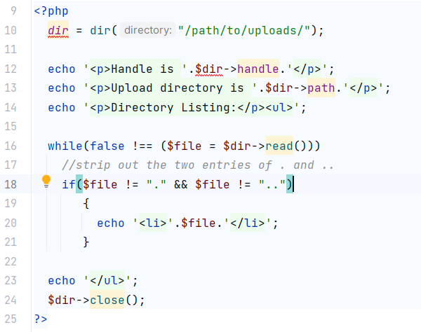
Using Directory Functions
Review
browsedir.php
and
browsedir2.php

Slide 9
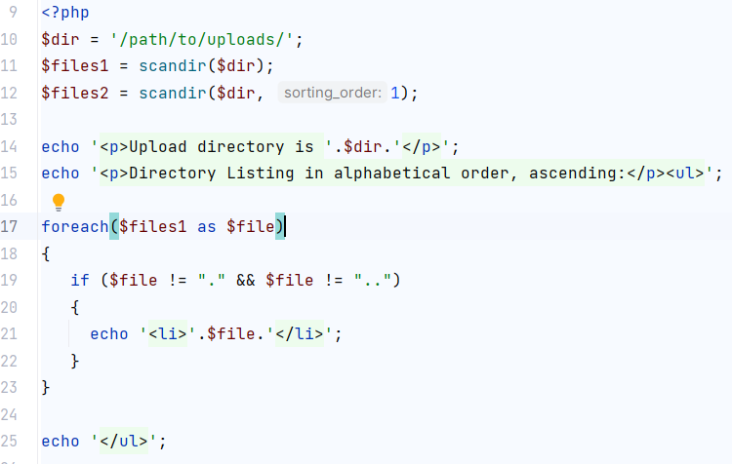
Scannig a directory for file list
Review
scandir.php

Slide 10
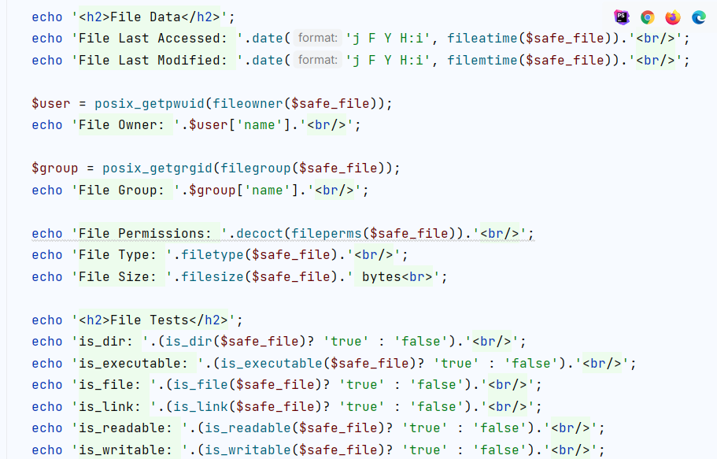
Querying for the file properties
Review
filedetails.php

Slide 11
References
Handling file uploads
https://www.php.net/manual/en/features.file-upload.php
Error messages/codes
https://www.php.net/manual/en/features.file-upload.errors.php

